Slide 1
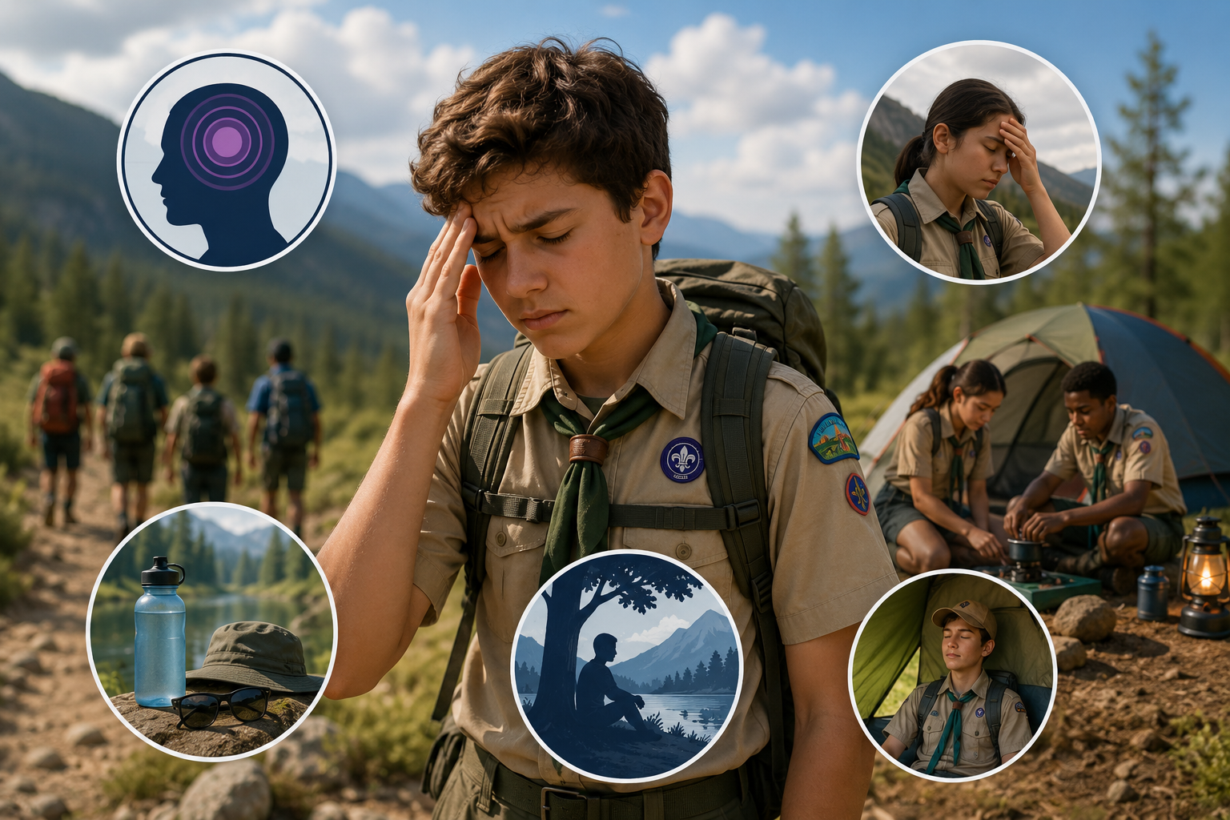
Migraine and Headache Awareness
The Facts: Migraines vs. Headaches
Migraines are not just "bad headaches"—they are complex neurological diseases that can last for days, causing throbbing pain, nausea, and severe sensitivity to light and sound.
Common Trail Triggers
On summer campouts, head pain is often triggered by preventable trail factors:
                Dehydration: Insufficient water intake.
                Overexertion: Pushing without proper pacing or rest.
                Sun Exposure: Lack of head or eye protection.
                Skipped Meals: Low blood sugar leading to head pain.
Notes:
It is a crucial to review safety protocols, educate troops on symptom recognition, and promote hydration to ensure that outdoor adventures remain safe and enjoyable. Let’s take a moment to understand the difference between a typical headache and a migraine. Migraines are not simply bad headaches. They are neurological conditions that can cause significant symptoms, including throbbing or pulsating pain, nausea, and extreme sensitivity to light and sound. A migraine can last for hours or even several days.
For Scouts, especially during summer campouts and hikes, there are several environmental and physical factors that can contribute to head pain or trigger a migraine.
First is dehydration. Scouts may be focused on keeping up with the group and forget to drink regularly. Encourage Scouts to drink water throughout an activity rather than waiting until they feel thirsty.
Second is overexertion. Hiking, climbing, or other activities can become more difficult in heat and humidity. Encourage Scouts to pace themselves, take appropriate rest breaks, and speak up if they aren't feeling well.
Sun exposure can also be a factor. Hats, sunglasses, sunscreen, and access to shade can help reduce the effects of bright sunlight and heat.
Finally, don't overlook meals. A Scout who skips breakfast or lunch may experience low blood sugar, which can contribute to headache symptoms and make them feel significantly worse.
The important point for leaders is: listen when a Scout says they don't feel right. Don't assume they're simply tired or trying to avoid an activity. Move them to a cooler or quieter location when appropriate, provide water and a chance to rest, and follow the Scout's established health and medication plan. If symptoms are severe, unusual, rapidly worsening, or accompanied by other concerning symptoms, seek appropriate medical assistance.
A little prevention and a willingness to listen can help keep a Scout safe—and keep a headache from turning into a much bigger problem.”

