Slide 1
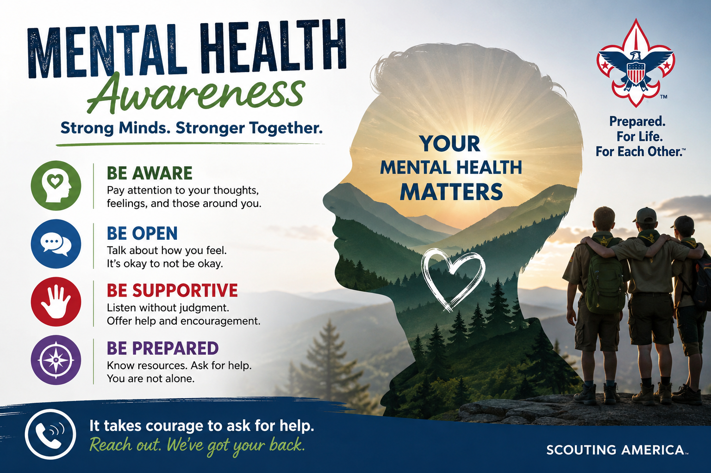
Mental health is just as important as physical health. In Scouting, we support the mental, emotional, and social well-being of every Scout and leader.
Notes:
As Scouts and leaders, we are committed to creating a safe environment where everyone feels respected, included, and supported.

Slide 2
Recognize the Signs
Watch for Changes
Possible signs someone may be struggling:
Withdrawal from activities or friends
Sudden mood or behavior changes
Increased anxiety or sadness
Loss of interest or motivation
Expressions of hopelessness or isolation
Remember: You do not need to be an expert to care
Notes:
Presenter Notes:
Sometimes, a Scout or adult may be struggling with their mental health without directly telling us. There may be changes in behavior that give us a clue that something isn’t quite right.
Watch for things like withdrawing from activities or friends, sudden changes in mood or behavior, increased anxiety or sadness, or losing interest in things they normally enjoy. A person may also express feelings of hopelessness, loneliness, or isolation.
It’s important to remember that these signs don’t automatically mean someone is experiencing a mental health crisis. But they are opportunities to notice, connect, and check in.
In Scouting, we have an important role to play. We don’t have to diagnose or fix the problem. Sometimes the most helpful thing we can do is simply say, ‘I’ve noticed you seem a little different lately. How are you doing?’ Then listen without judgment and help connect them with a trusted adult, parent, leader, or professional when appropriate.
Being prepared means looking out for one another-not just on the trail, but for our mental well-being, too.

Slide 3
What Scouts & Leaders Can Do
Support Each Other
Use the Scout Oath and Law
Be Kind
Be Helpful
Be Friendly
Practical Actions
Listen without judging
Include everyone
Encourage trusted-adult conversations
Speak up if someone may be at risk
Know when to seek professional help
Notes:
Presenter Notes:
Recognizing that someone may be struggling is only the first step. The next step is knowing what we can actually do.
First, listen without judging. We don’t need to have the perfect answer. Sometimes giving someone our attention and letting them know they are heard can make a real difference.
Second, include everyone. A simple invitation to join an activity, sit with the group, or participate can help someone who may be feeling isolated or disconnected. Inclusion is something every Scout and Scouter can contribute to.
Third, encourage trusted-adult conversations. Scouts should know that it’s okay to talk with a parent, guardian, Scout leader, teacher, counselor, or another trusted adult when something is bothering them.
Fourth, speak up if someone may be at risk. If you are concerned that someone could hurt themselves or someone else, don't keep that concern to yourself. Get a responsible adult involved and follow Scouting's safety procedures.
And finally, know when to seek professional help. Mental health challenges are not something we are expected to diagnose or treat as Scout leaders. Our role is to recognize concerns, provide support, and help connect the individual and their family with appropriate professional resources.
The most important message is simple: You don't have to fix someone's problem to make a difference. Listen, include, encourage, and speak up.

Slide 4
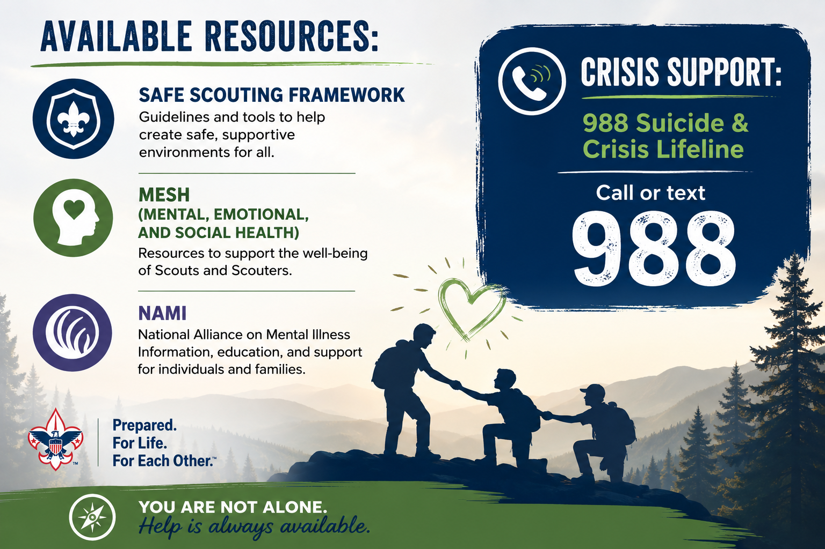
Mental Wellness Resources
Notes:
Presenter Notes:
Knowing where to turn for help is an important part of being prepared.
There are several resources available to help Scouts, families, and Scouters better understand and support mental, emotional, and social health.
The SAFE Scouting framework provides guidance for creating environments where young people feel safe, supported, and able to ask for help. MESH resources focus specifically on mental, emotional, and social health and can help leaders recognize concerns and respond appropriately.
The National Alliance on Mental Illness, or NAMI, is another valuable resource for information, education, and support for individuals and families dealing with mental health challenges.
And if someone is experiencing a mental health crisis, emotional distress, or thoughts of suicide, remember the 988 Suicide & Crisis Lifeline. You can call or text 988 to reach trained crisis counselors.
As Scout leaders, we don't need to be mental health professionals. Our responsibility is to notice, listen, support, and connect people with the right resources when they need them.
The key takeaway is: Know the resources before you need them. Being prepared can make a difference when someone is having a difficult time.

