Slide 1
Welcome to:
Acclimating the New Scout and Their Family to Your Unit
Notes:
When doing this training in a classroom setting, role play while the class enters the room. Focus on a half of the participants and ignore the other half.
Before going to the next slide, apologize to that half who was ignored and let everyone know about the “unknown” role play and ask how each group felt. This will lead us into an interactive class.
Ask the audience who has taken the New Member Coordinator training and /or attended the previous NMC course…..
Can bypass a majority of the NMC slides if they attended the previous NMC course

Slide 2
Course Objectives
Understand & Discuss the “Whys”
Understand why youth and families joined Scouting
Understand why youth and families might leave Scouting
Who can help acclimate your new Scouts and their parents
How to create a sense of belonging for new & existing Scouts and their families (Acclimating)
Resources + Q & A
Notes:
Once you understand the “Why” you can then tackle the “Who” and the “How”.
You need to make everyone feel welcome!!!!
Re-thinking how we can acclimate your new youth and their families to your unit. This approach can lead to increased retention (youth & adult) along with parental involvement, which could lead to grow in membership.

Slide 3
Why youth and families joined Scouting

Slide 4

What the youth want………….

Slide 5

What the parents want…………
Notes:
Parents want their children to have fun, but that might not be the primary consideration. When talking with the parents, you need to “actively listen” to hear their concerns. Each parent could have slightly different concerns. Fitting in is a main concern.
What are the typical questions and concerns a new family would experience when joining a Pack or a Troop? Especially if the parents didn’t grow up in Scouting?
(With an interactive, fact-to-face presentation, ask for audience ideas. Write responses on chart paper or have a volunteer write on the chart paper.)
Now that you have been part of a Pack and a Troop for a while, what have you seen that helps you identify the concerns new youth and families may have about the pack and troop?
An example of a parent’s concern & want can be associated working with youth with disabilities. Can your meeting location accommodate youth with disabilities? What is your unit’s (youth & adult) “Level of Awareness” to welcome and work with those youth with disabilities?
{Ask for those other concerns}
Now go to the next slide.

Slide 6

What the parents want…………

Slide 7

NEW MEMBERS
JUST
WANT TO
“FIT IN”
and have
a sense of belonging
Includes both youth and adults with disabilities
Notes:
Think about it…New Scouts and their families went through a selection process to find your pack or troop, and once they have joined, both the Scouts and their parents just want to “fit in”. Please remember to directly follow up with a family that has been absent unexpectedly for the past 2 meetings or events. Actively listen why they were not in attendance and let them know they have been missed and invite them to your next meeting or event.
Helping new families feel a sense of belonging and “fitting in” is the primary role of the New Member Coordinator. When a friendly and welcoming New Member Coordinator anticipates and addresses parents' questions and concerns, parents are much more likely to feel positively about their Scout's initial experiences and will encourage their Scout to continue in Scouting. A friendly face greeting a new Scout and their parents as they arrive for meetings helps everyone get over the initial “butterflies” about joining a new group. By just being there, being available for questions and conversation, the New Member Coordinator makes a huge difference in a new family’s transition into the troop. Another example of welcoming includes how you include youth and families with disabilities. Can your meeting location accommodate youth with disabilities? What is your unit’s (youth & adult) “Level of Awareness” to welcome and work with those youth with disabilities?

Slide 8
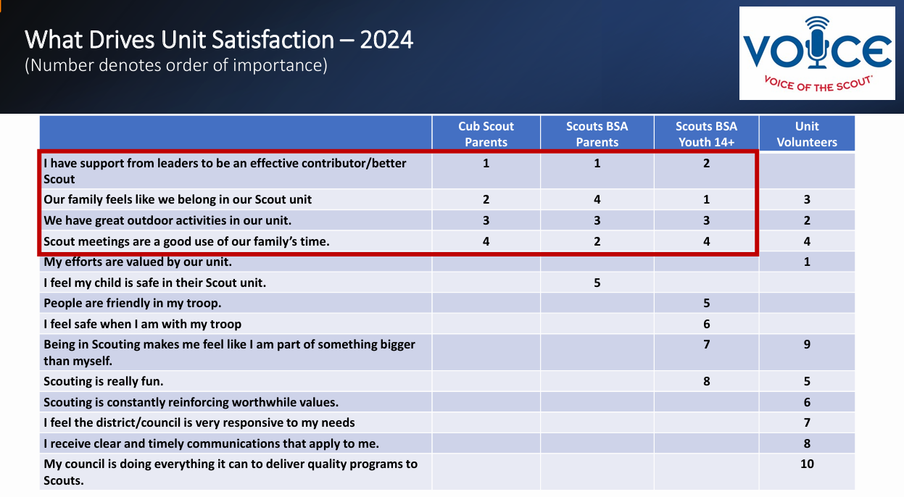
Notes:
What is the Impact to Improved Retention – Brainstorming Session:
Based on what we shared this morning, how can your Retention goals help Drive Unit Satisfaction?
Please share ideas of the potential Action Steps you will consider to improve your council’s Retention. (Record on Flip Chart)
Have this slide up as the group shares ideas.

Slide 9
Why youth and families might leave Scouting
Notes:
To Better Acclimate Scouts and their families, you should first need to understand why they might leave. The following 5 slides contains information related to both Packs and Troops.

Slide 10
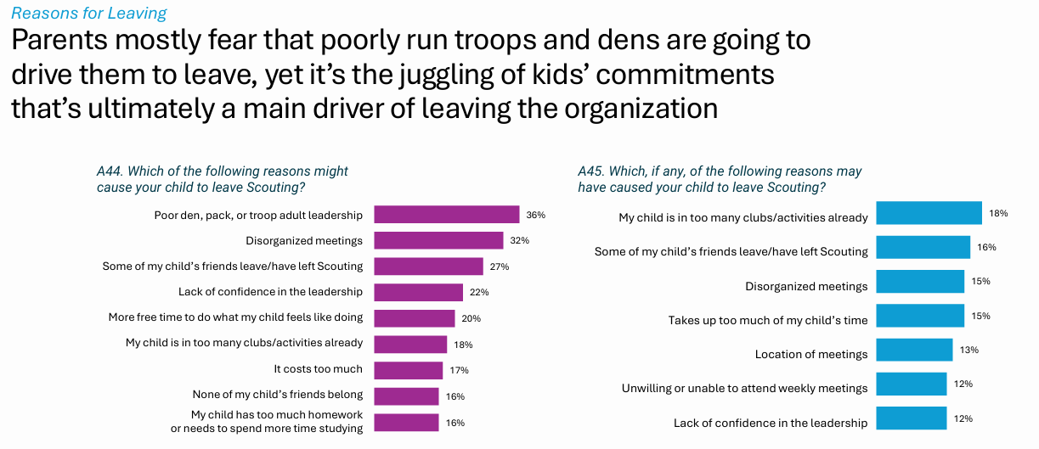
Notes:
Scouting Exit Survey
• Sample included youth with dropped Member ID that expired June 1, 2024, to December 31, 2024.
• Survey was sent on April 3, 2025 (after 90 day lapsed period ended)
• Survey was sent to 172,136 parents for whom we had valid emails or to youth who were over 14 if no valid parent email was present.
• 8,732 survey were completed for a response rate of 5.1%
• Less than a 1% margin of error at the 95% confidence level for parent responses
Packs vs. Troops Takeaway:
Packs: Parents makes the connections (belonging)
Troops: Youth makes connections (belonging)

Slide 11
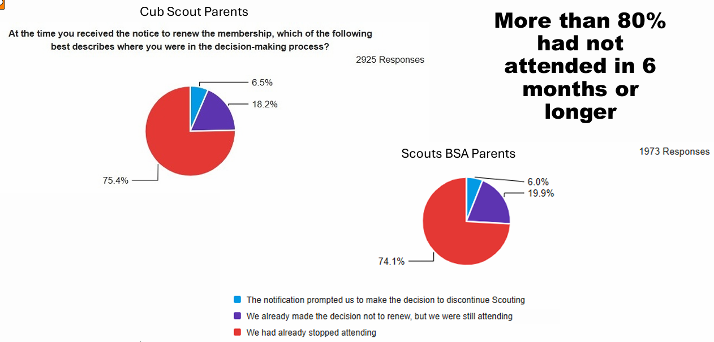
Notes:
The key takeaway of this slide is that more than 80% of those who dropped had not attended in 6 months or longer. Truly the impact of disorganized meetings.
Where are potential breakdowns within units? Does this become “Proactive” or “Reactive”?
Who can help reverse this trend so a unit can become “Proactive” to greatly reduce the surprises come Membership Renewal time?

Slide 12
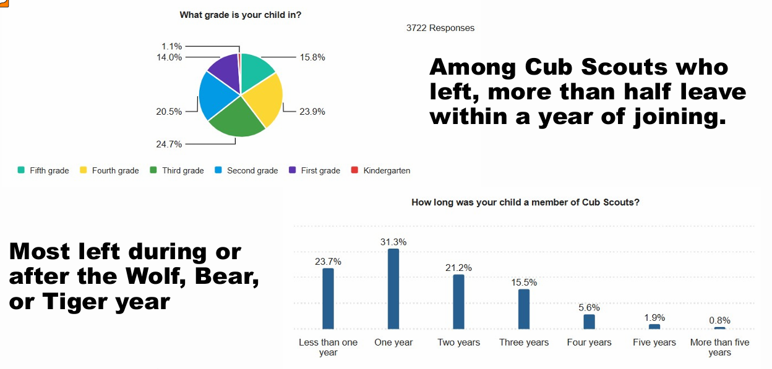
Notes:
Focal Points:
Among Cub Scouts who left, more than half leave within a year of joining
Most left during or after the Wolf, Bear, or Tiger year

Slide 13
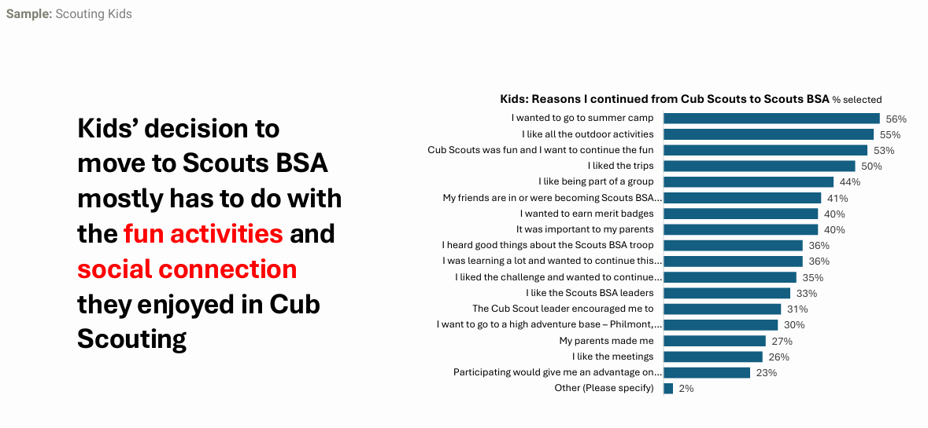
Notes:
Start of Troop data
Focal point is the kid’s decision statement.

Slide 14
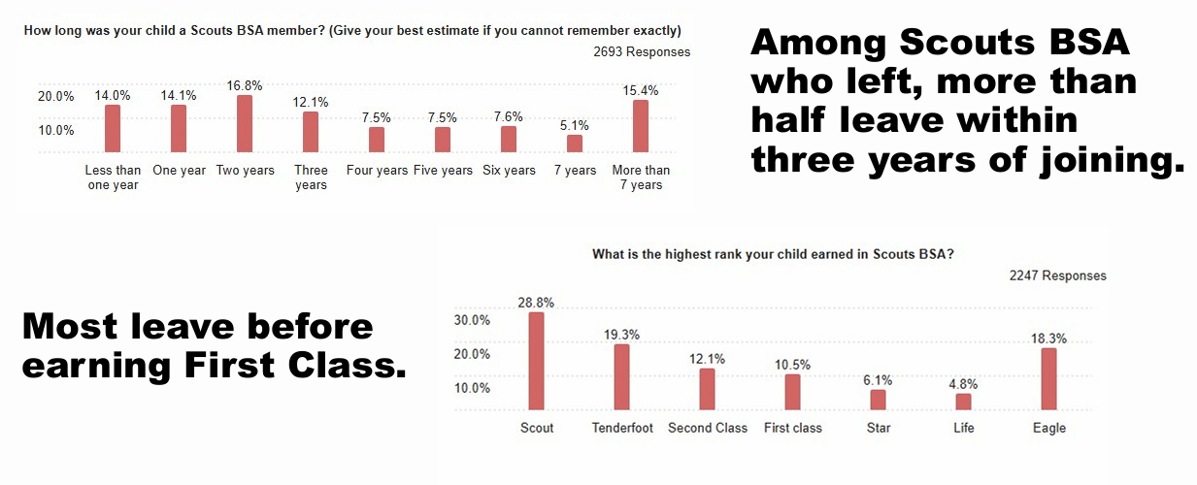
Notes:
Should consider hold a Scoutmaster Conference with any youth who has not advanced in a year.
Another goal is to have your new Scouts achieve their Scout Rank within the first 3 months of crossing over.
Additional focal points:
Among Scouts BSA who left, more than half leave within three years
Most leave before earning First Class

Slide 15
Who can help acclimate your new Scouts and their parents

Slide 16


First, we need to remember that our new Scouts & Families need to be:
Seen
Heard
Validated (Included)
This even holds true for our existing
Scouts and their families!!!!

Slide 17


WHO can make a good New Member Coordinator?
Notes:
Why do we need New Member Coordinators? Why do we need them NOW?
Scouting needs welcoming and relationship-building teams now more than ever!
New Member Coordinators are the solution to many of the issues dens, packs, troops, ships and crews face when integrating new youth and their families into the Scouting program.
Who can make a good NMC: Any registered adult who cares about Scouting and would enjoy building friendships with today’s families so that they develop an immediate and continuing sense of belonging

Slide 18
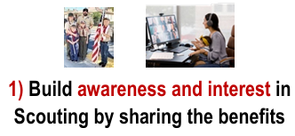

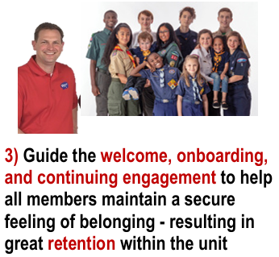
New Member Coordinator
Elements of the Job
Notes:
Purpose behind each of the 3 Elements of the Job
Helps families see that Scouting would be a good fit for them
Help families that your unit is a place where they truly feel at home
Help families feel such a strong sense of belonging that they want to stay (Retention)
The function of the New Member Coordinator is FLEXIBLE and ADAPTABLE TO YOUR UNIT’s SPECIFIC NEEDS and your parents’ SPECIFIC INTERESTS. The 3rd element applies to both the new and existing Scouts and their families!!!
This can be achieved by understanding the details on the next slide.

Slide 19

Build Awareness and interest
  Tell the story of how local Scouts are having fun with a purpose
  Showcase Scouting in your community
Coordinate effective recruitment
  Help the unit be prepared for new members
  Use BeAScout effectively
Guide the welcome, onboarding, and continuous engagement
  Collaborate with leaders (adults and youth) to help everyone focus on how best to welcome new members
  Take steps to be sure every youth and family is positively engaged over the next 30 days – and over the following months and years
  Keep track of youth and family attendance and engagement over time
    This Job Element applies to both new and existing Scouts and families and this builds “Belonging”
  Celebrate Scouts!!!!
Description for each elements of the job
Notes:
A great idea is always more successful when everyone involved feels a strong emotional investment, a sense of ownership of the planning and follow-through so they personally make it work and can be proud of what they’ve accomplished.
[If time, discuss strategies for sharing success stories and establishing ownership and pride. Initial discussion should focus on the importance of Tracking and Reflection/Assessment]
Tracking & monitoring includes working with your Committee and Advancement Chairs to ensure that your new and existing scouts are attending meetings and events along with advancing.

Slide 20
WHAT do New Member Coordinators do to build belonging?
Showcase
KEEP IN TOUCH
KEEP LISTENING
KEEP ENCOURAGING
KEEP ENGAGING
Share
Invite
Inform
Greet
Welcome
Provide
Engage
Notes:
So, non-member families feel that Scouting would be a good fit for them:
SHOWCASE Scouting, emphasizing the fun, learning, and the service
SHARE how Scouting benefits youth, families, and community
INVITE today’s families to be part of outings and service to others
INFORM about local unit leadership, program, and meeting place/time
So, everyone feels at home in the unit:
GREET potential members and help them to join Scouting
WELCOME new members and help them get to know others
PROVIDE unit welcome and contact information so that non-member families feel that Scouting would be a good fit for them so that everyone feels at home in the unit
ENGAGE new members immediately and continuingly
The last 4 bullet points, starting with “KEEP”, are important as they deal with all members in a unit. The focus of these tasks are so that all members feel valued and know that someone cares, including contacting them if they are not participating (Proactive Retention).
These 4-bullet points focus on the third element of the NMC Job and are important so that all members feel valued and know that someone cares, including contacting them if they are not participating [A strong sense of belonging = good retention]

Slide 21
How to create a sense of belonging for new & existing Scouts and their families (Acclimating)

Slide 22
Welcoming / Onboarding Best Practices
Be that friendly face
  Continue close contact
  Let families know you are there for them and they can count on you
  Thank them for coming
You do not need to know all the answers but promptly follow-up or direct them to those who could answer that question or concern
Make a “top 5” list of things a new youth and their family would need to know
  Don’t overthink it!!!!!
  Have your contact information available
  Ensure you have the contact information of all your new families
  Have your unit calendar available
  Control that flow of information and watch the use of Scouting Jargon
https://blog.scoutingmagazine.org/2021/08/12/make-sure-new-families-in-your-pack-have-this-info-as-soon-as-they-join/
Notes:
This is where a New Member Coordinator (NMC) can create a welcoming environment for the new parents. Your NMC can also help get the parents engaged to support unit functions by having them fill out either the Family Survey or the Troop Resource form.
Please note: the use of the Family Survey and Troop Resource forms are suggestions and not required. Explain to your new families that these forms are meant to help units understand the experiences and strengths of their parents so, they can set up the parent for success when asking for their assistance. Do not force a family to fill out these forms if they are unsure or hesitant.

Slide 23
Welcoming / Onboarding Best Practices
Ask yourself, “How is your unit leadership’s awareness and your meeting location accommodations for those with disabilities?”
Follow-up and monitor both new and existing Scouts and their families
  Do they attend outings, Den / Patrol meetings and Pack Night / Court of Honor?
  Is their child advancing?
    Scout Rank can be earned within 3 months of crossing over
    First Class can be earned before going to High School
Should always be alert to new youth and their families who join throughout the year
Notes:
Ask for other thoughts and ideas from the audience……..
The most important information to impart to a new family is how to make it to their first Cub Scout meeting.
A family needs the time, date, and place of the meeting as part of the “onboarding” journey.
Onboarding means getting new Scouts and parents looped in with what’s going on in your unit and demonstrating the welcoming atmosphere of your unit, whether Cub Scouts or Scouts BSA.
If someone doesn’t come from a Scouting background, they may not know the difference between a “den” and a “pack.” They likely have no idea how often Scouts meet, and they certainly don’t know when and where your unit meets.
That’s why it’s critical to give new families this info as soon as possible, as simply as possible. Then, parents and kids have a foundational understanding of how Cub Scouts is structured, and you can ensure they make it to that first, crucial meeting.
Giving new families the info they need to stay engaged in Scouting and pursue volunteer opportunities is our shared goal.
The basic premise of Scouting for youth with disabilities is that all youth want to participate fully and be respected like every other member of the unit. While there are, by necessity, units exclusively composed of Scouts with disabilities, experience has shown that Scouting usually succeeds best when every Scout is part of a regular unit.

Slide 24








Scouting is
compatible
and adaptable
with other
youth
activities
Flexibility
is the key!!!
Religion
Classes
Notes:
Other points of consideration, which will require Active Listening:
Some families leave Scouting due to a lack of understanding of how Scouting can “fit-in” with other extra-curricular activities, from sports to music to religion classes and more. A New Member Coordinator can be instrumental in explaining how Scouting is compatible with a wide range of other youth activities. They can share that most Scouts do participate in other activities by providing examples of how those families make it all work.
We can stress that while sports is seasonal, Scouting is year-round!!!
Remember, flexibility is the key!!!! Scouting needs to be compatible and adaptable with other youth activities.

Slide 25
Decision making Process when deciding to join an association
Member-Shift by Sarah Sladek
Diagram #1: Generations born prior to 1981
Diagram #2: Generations born since 1982
Expected
Observe
Participate
Belong
Invited
Belong *
Participate
Appreciate
(*) New Member Coordinator plays a key role in this phase
Legend:
Phase 1
Phase 2
Phase 3
Phase 4
Notes:
This concept looks at shifting away from our current outdated models (compare diagram 1 vs 2). Information is based on the book titled Member-Shift by Sarah Sladek. This book discusses why members leave and the strategies proven to bring them back. While the book does not mention Scouting directly, the reader can apply the contents discussed in this book to what we see in Scouting today.
The process to join organizations has shifted, but one thing remains the same: At the core of our being, all people want to belong. This is true whether a family is thinking of joining or is thinking of returning (rejoining) the next year. Need to get away from asking parents to be the Den Leader at Recruitment Night (goes with eliminating the “stick-up” recruitment booths – high pressure sales pitch). The 2nd diagram correlates with the suggestions contained in the next 3 slides. The following bullet points explain the meaning behind each phase in Diagram #2.
Invited: Joining and staying is a choice.
Belong: Belonging needs to happen immediately. There’s a greater call to action, and families feel welcomed into a unit that is positive, inclusive and innovative.
Participate: Deciding to join ti deciding to get actively involved. Do not be afraid to start small. Participation is instantaneous, community driven, and action orientated.
Appreciate: Members of all ages want to feel valued and important. Families dislike it when their efforts are ignored or overlooked. Appreciation is important, especially since they chose to join and get involved (as opposed to feeling obligated).

Slide 26

“Actively Listen” to your new families during your conversations to learn their “passion”, concerns, and availability
Start small (examples)
  Do not be that “Bull in the China Shop”
  Ask a family to bring treats
  Engage them in an activity / support role…the key is to make it interactive
    Assist with a unit event
      Not to be that chair / lead
    Drive Scouts to an outing
    Take Scouts shopping to get food for their patrol
    What are examples of other support roles?
If they are a Leader, get them Trained!!!
Utilize the Cub Scout Family Talent Survey or ScoutsBSA Troop Resource Survey
  Links are in the notes section of this slide
How to involve Parents
Notes:
Ask audience for their thoughts on how to involve parents
Explain the “Active Listening” skill set. Always have a “Plan B” when talking with your parents and Active Listening will allow you to her that parent’s true passion as you encourage them to fill out the Talent Survey. Parent Contact information is at the bottom of the form.
Examples of parent support roles: judge a Pinewood Derby Race, drivers, merit badge counselors, event helpers, sharing den meeting responsibilities
Cub Scout Talent Survey Link:
https://filestore.scouting.org/filestore/CubScoutMeetingGuide/PDF/Appendix/34362.pdf
ScoutsBSA Troop Resource Survey Link:
https://filestore.scouting.org/filestore/pdf/512-116_WB.pdf

Slide 27
Joining and Belonging – First Meeting & Beyond
Ensuring the Ideal First 10-Minute Experience
Ensuring New Families Attend Their First Meeting
What New Scout Parents Need to Understand Right Away
What New Scouts Need to Understand Right Away
Following Up With Families Who Drift Away, especially in the first 30 days
Notes:
Note: These 5 topics can apply to both new and existing Scouts and their Families.
Ensuring the Ideal First 10-Minute Experience
How do we ensure that every new family (adult and youth) gets that ideal first 10-minute experience every time?
What specific actions must happen in those first 10 minutes?
Who is responsible for each action?
What systems or habits make this consistent, not accidental?
Ensuring New Families Attend Their First Meeting
What can we do to ensure new families attend their first meeting or activity after registering?
What might parents and new Scouts feel before their first activity or meeting?
What communication or touchpoints matter most before the first activity/meeting?
What reduces anxiety or uncertainty for new parents?
What New Scout Parents Need to Understand Right Away
What do new Scout parents need to understand in (a) their first meeting/activity and (b) their first 30 days so they feel confident about what Scouting will look like for their child and for themselves?
What do parents need to know right away?
What do they need to understand in the first month?
What builds confidence and reduces confusion?
What New Scouts Need to Understand Right Away
What do new Scouts need to understand in (a) their first meeting/activity and (b) their first 30 days so they want to continue to participate?
What helps youth feel welcomed and excited?
What helps them feel like they belong?
What early experiences make them want to come back?
Following Up with Families Who Drift Away
What’s the best way to follow up with families who came once or twice and then disappeared?
Who should reach out — and how soon?
What kinds of invitations bring families back?
What tone and message works best?
We know we do lose many families within the first 30 days. This is where a phone call or text, letting them know they are important part of your unit.

Slide 28
ReTENtion: Ten Ways Relationships Help Scouts Stay
WELCOME: Retention begins in the Parking Lot
  Before a parent / family walks through the door
NAME: Use the Power of the Name
  Recognition builds belonging
NOTICE: Notice When Someone is Missing
  Your presence matters
SEE: See the Scouts Others Overlook
  Look for the quiet Scout
CONTRIBUTE: Invite Every Scout to Contribute
  Everyone has something to give
TRUST: Earn the Trust of Parents
  Safety builds confidence
CELEBRATE: Honor the Journey
  Through celebration of accomplishments
BELONG: Build a Place Scouts Do Not Want to Leave
  Build a place they love
PATROL / DEN: Strengthen the Patrol or Den Bond
  Friends help us stay
MENTOR: Be the Adult Who Believes
  Believe in their potential
Based on a book by Rev. David Weyrick

Slide 29


